Slide 1
Futsal Field Reservation System
Developed By:
Ehtisham Naveed
CK-FA-21-110734
Saadullah
CK-FA-21-110420s
Supervised By:
Mam Nazish Bashir
Program:
Computer Science
Session:
Fall 2021 to Spring 2025
Department of Computing & Technology
Iqra University Islamabad Campus (Chak Shahzad)

Slide 2
Contents
Introduction
Problem description
Proposed Solution
Aims and Objectives
Methodology
Prototype
Question Answer session

Slide 3
Introduction
Transforming football experiences in Rawalpindi and Islamabad.
Our innovative platform simplifies futsal ground bookings, saving time and effort for local teams. We enable seamless scheduling, connect players, and support ground owners in managing facilities efficiently.
With added features like football academies and a donation system for underprivileged players, we are dedicated to fostering accessibility and professionalism in local football.

Slide 4
Problem Description
Challenges in Booking Football & Futsal Grounds in Pakistan
Currently, players in Pakistan face a tedious, time-consuming process to book futsal and football grounds, with no central hub to streamline reservations. They must call multiple ground owners, wasting time and energy. Even when a slot is secured, finding opponents can be difficult.
For ground owners, this leads to mismanagement, sporadic bookings, and lost revenue. Aspiring players, particularly from underprivileged backgrounds, struggle to access training and facilities. These barriers hinder the growth of football culture and local community involvement.

Slide 5
Proposed Solution
Our platform simplifies futsal ground booking and facility management, providing ground owners with an easy way to list available slots, streamline reservations, and increase revenue.
Players can search, book, and arrange matches without the need to contact multiple ground owners.
Additional features include academy registration for all ages to enhance skills and a donation system to support underprivileged players.
Add Ai Futsal assistant to get information of Grounds and teams

Slide 6
Aims and Objectives
Aim:
By offering a centralized, user-friendly platform, the project aims to enhance accessibility, promote football culture, and create a more efficient, profitable business model for ground owners.
Objectives:
1.Simplify the Booking Process
2.Optimize Facility Management
3.Promote Football Culture & Skill Development
4.Support & Scalability

Slide 7
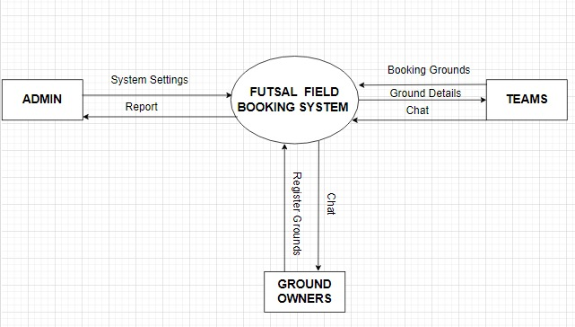
Methodology

Slide 8
Cont..
Tools:
React Js,html, CSS, JavaScript
Node js, Express Js
MONGODB
Firebase

Slide 9
Cont..
Data Collection:
It will involve conducting interviews with football players and ground owners to identify pain points and feature preferences. Additionally, focus groups will be organized to gather insights on desired functionalities, while competitor analysis will be conducted to benchmark against similar platforms for best practices.
Front-End Design:
We will utilize tools like HTML, CSS, JavaScript, and ReactJS to create a dynamic and interactive interface.
The frontend will feature a user-friendly interface with consistent colors, interactive elements like buttons, booking forms, and search bars to ensure seamless navigation and ease of use for both players and ground owners.

Slide 10
Cont..
Backend:
In the backend step, we will use Node.js and Express.js to handle server-side logic and manage user requests efficiently.
MongoDB will serve as the database to store and manage unstructured data such as user profiles, bookings, and ground information.
The backend will facilitate features like user authentication, ground booking management, team coordination, and donation processing.
The system will also ensure smooth integration between the frontend and backend, with secure handling of data and real-time updates for users.

Slide 11
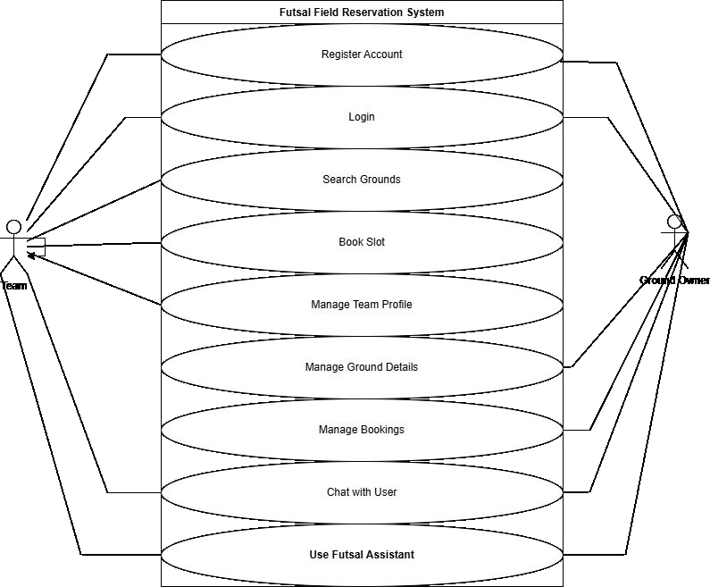
Use Case Diagram

Slide 12
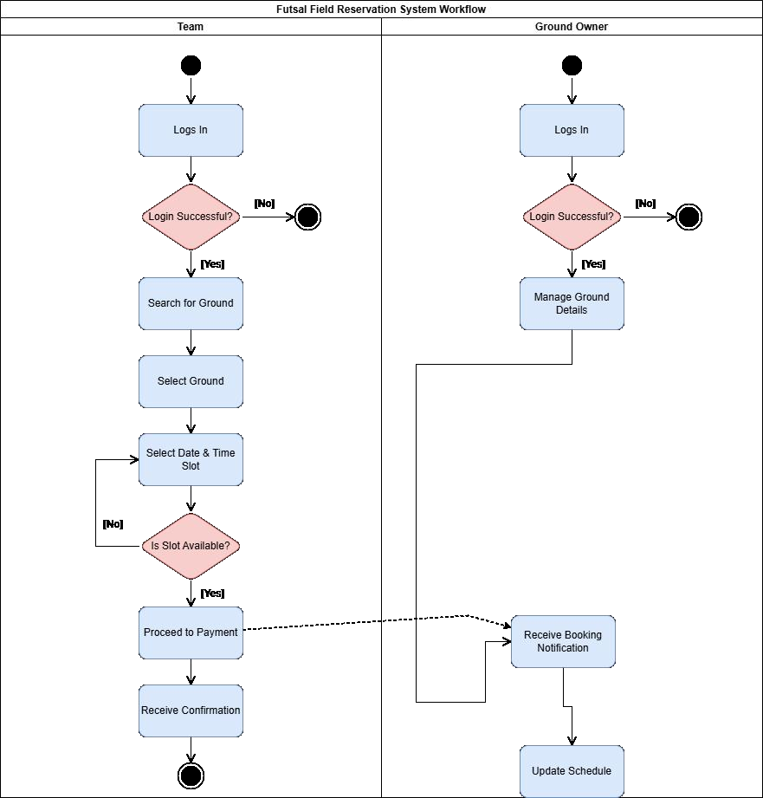
Activity Diagram
Diagram:

Slide 13
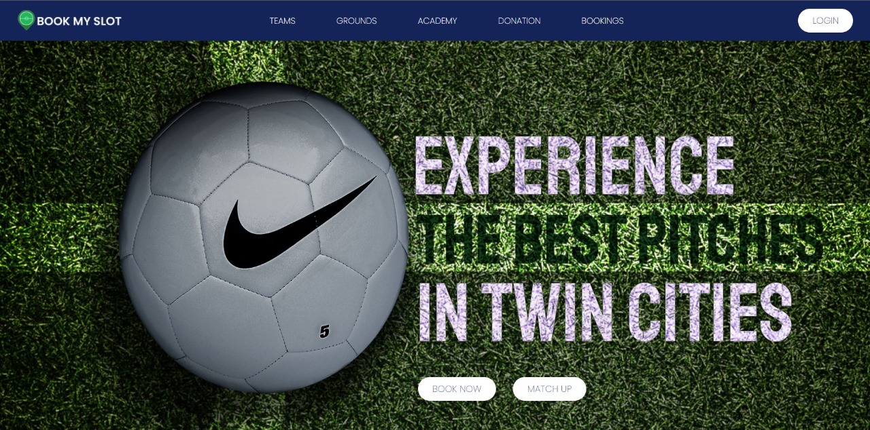
Prototype
Dashboard:

Slide 14
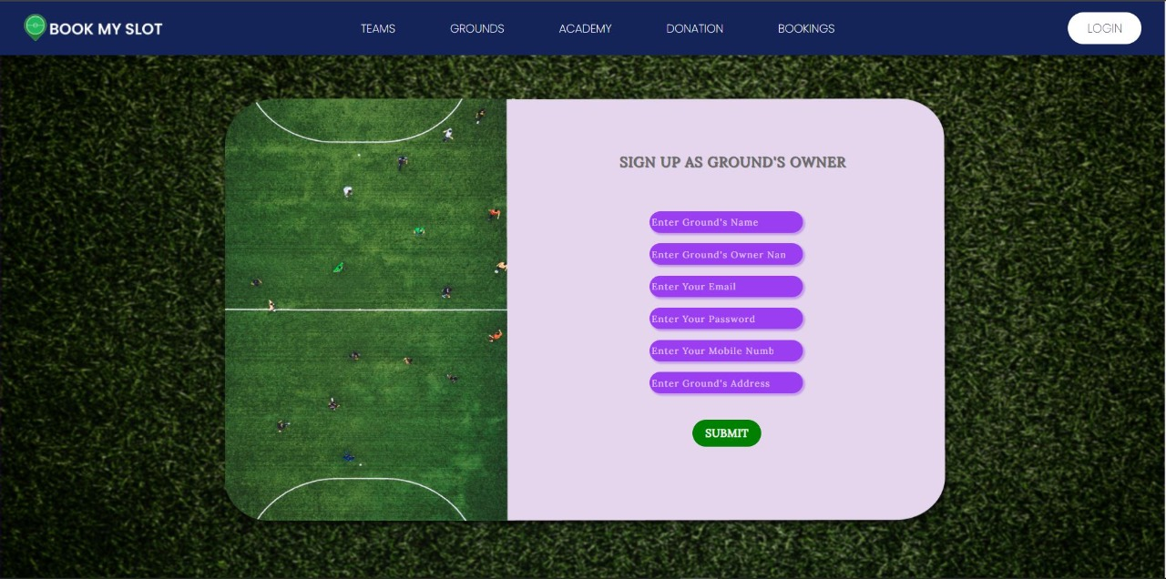
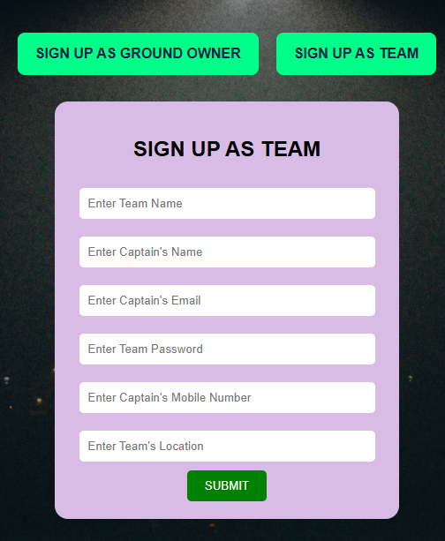
Signup(Ground Owner/ Team) Dashboard

Slide 15
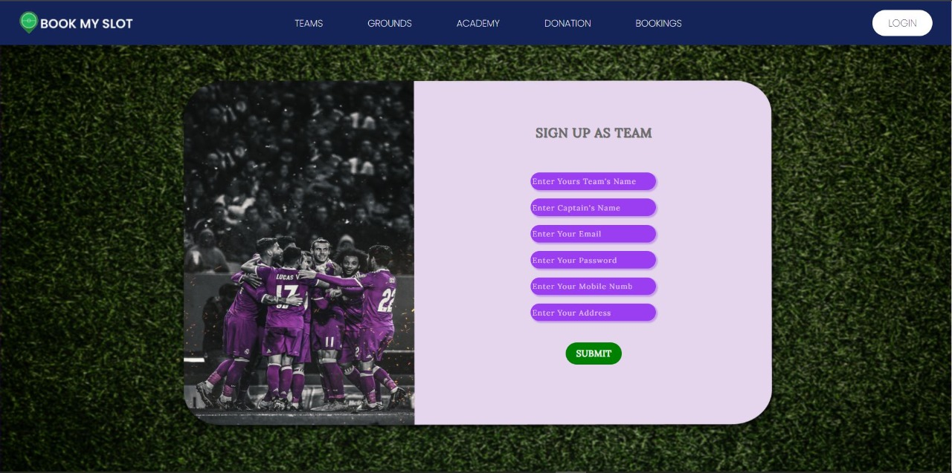
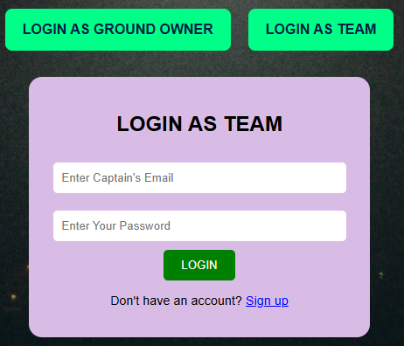
LOGIN(Ground Owner/Team) Dashboard

Slide 16
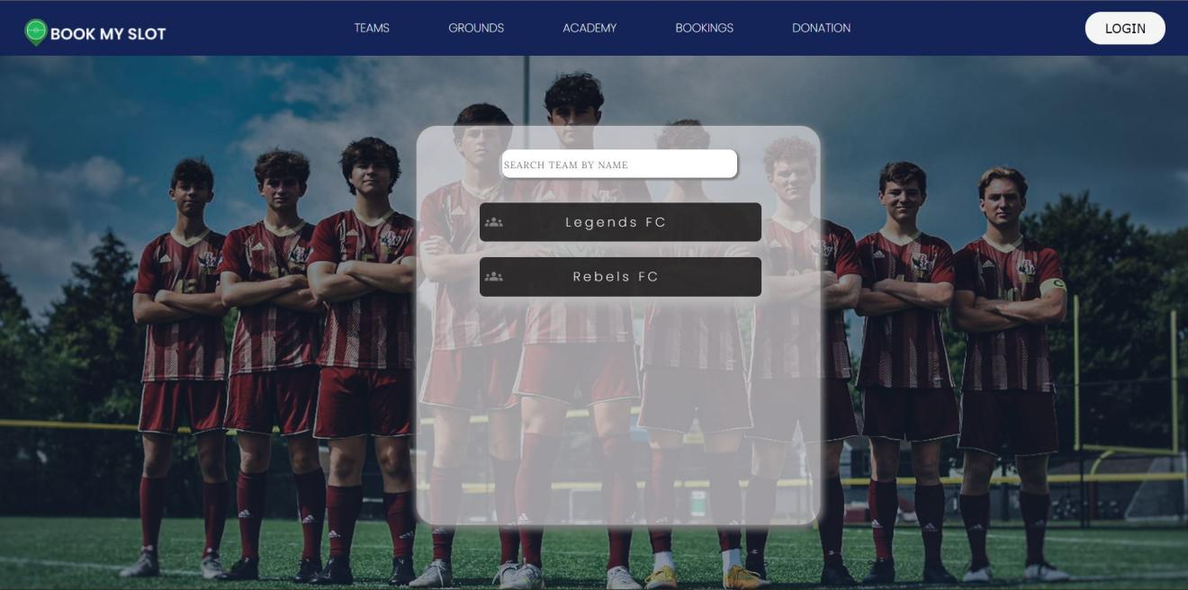
Teams Dashboard

Slide 17
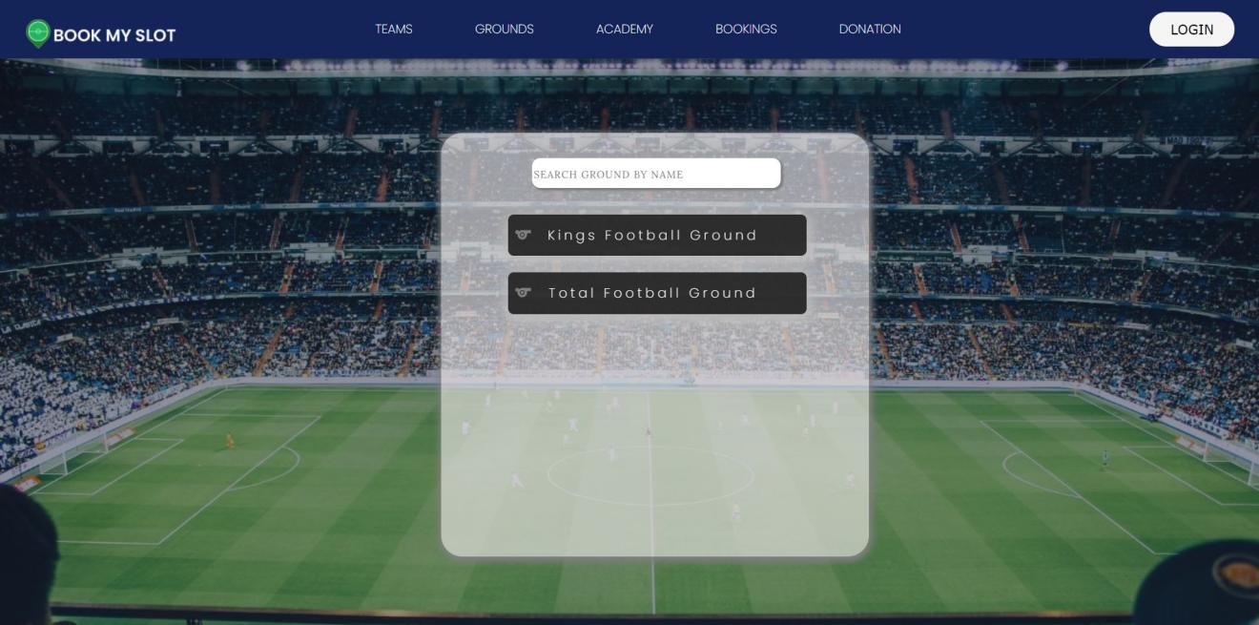
Ground Dashboard

Slide 18
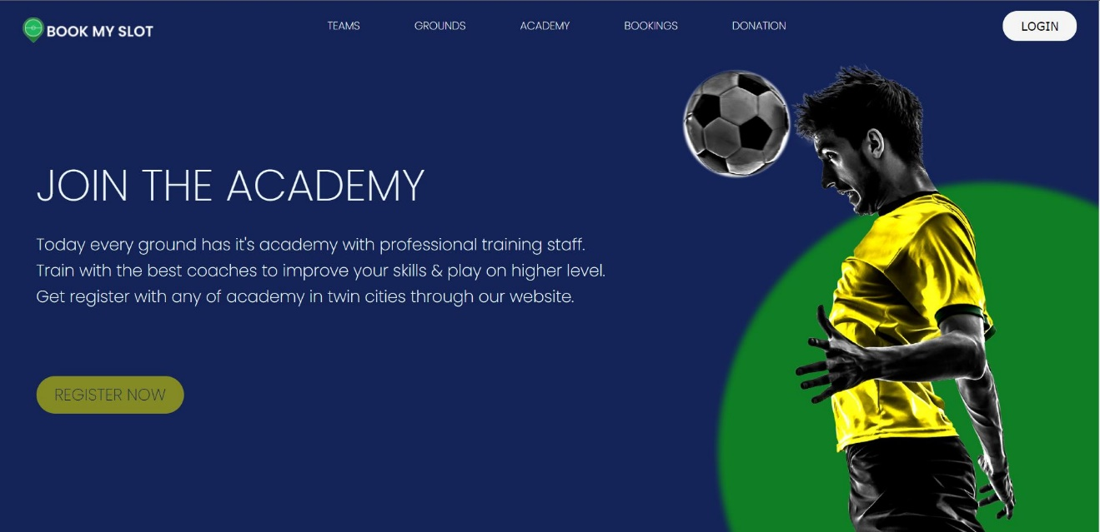
Academy Dashboard

Slide 19
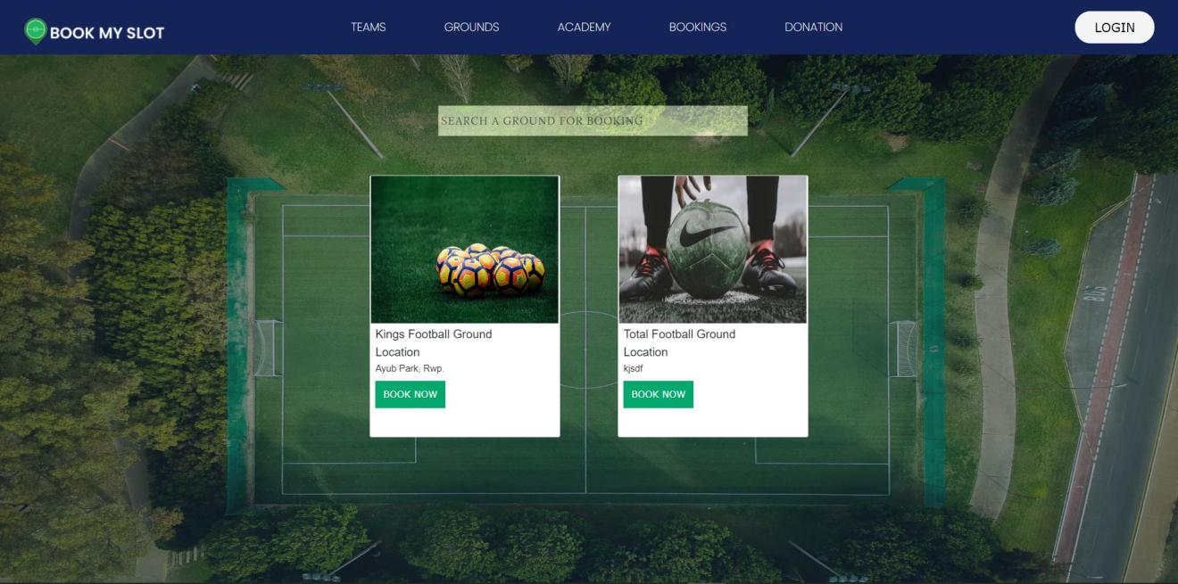
Bookings

Slide 20
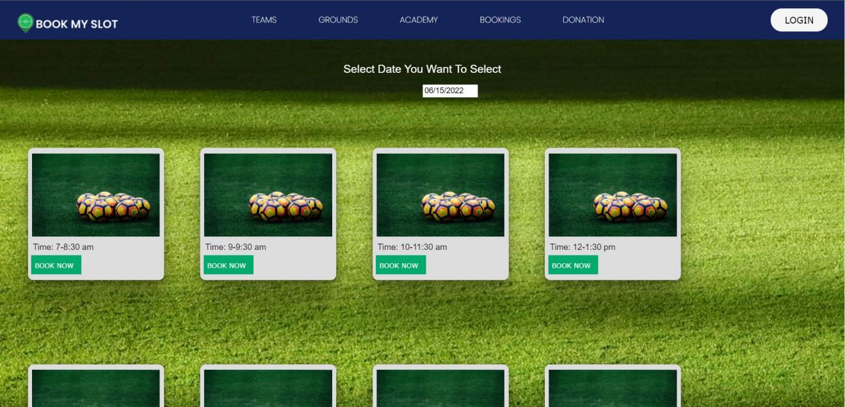
Slots Timing / Available Slots

Slide 21
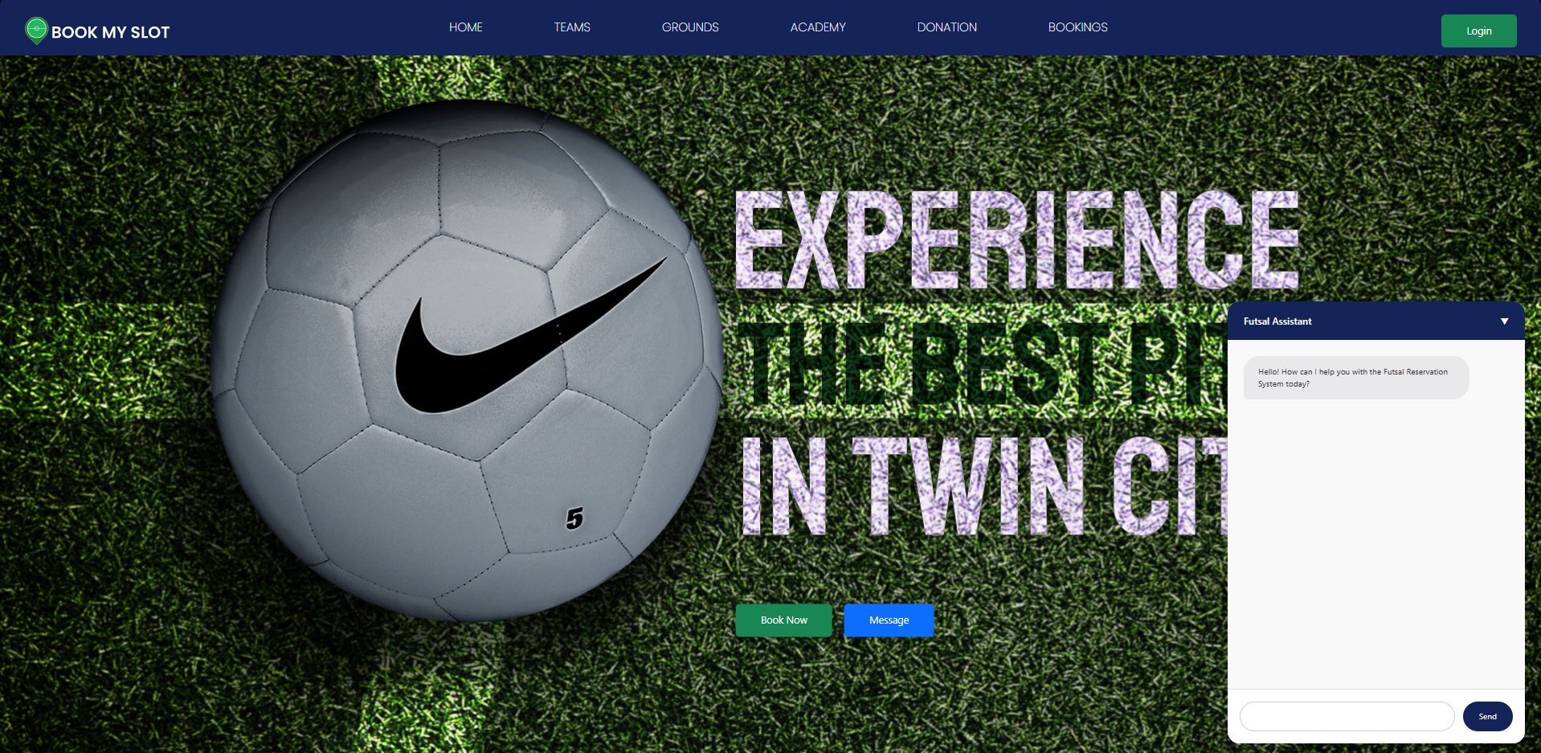
Chat Box

Slide 22
Any Questions?

Slide 23
THANK YOU

